Slide 1


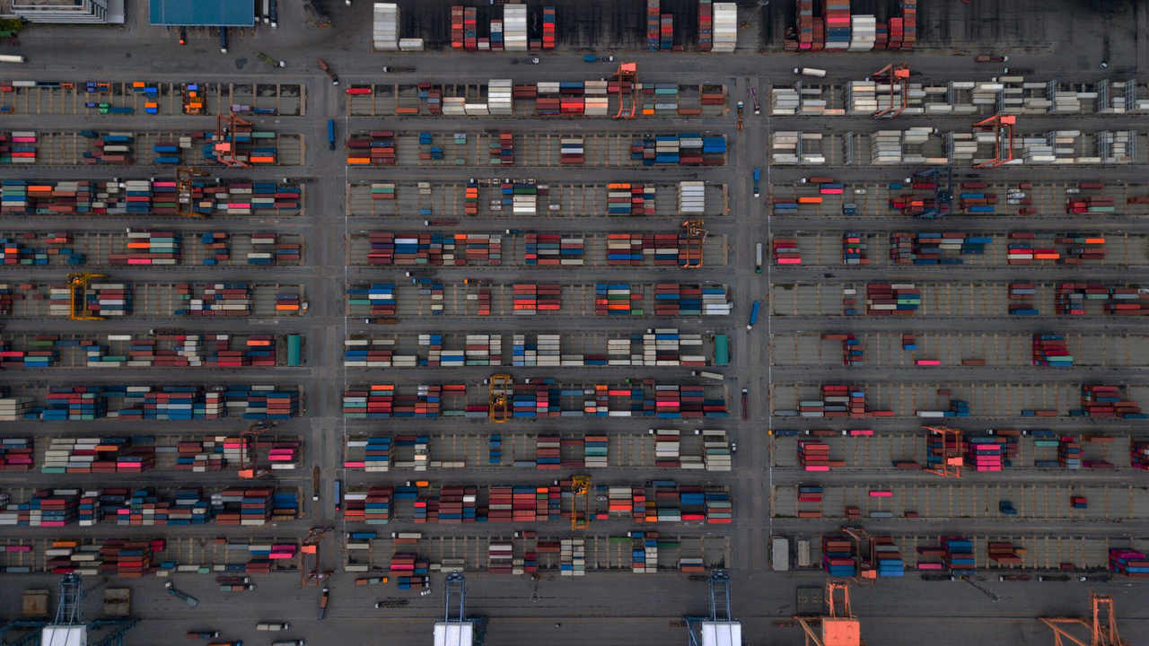

Containerisierung at Swiss Post IT
Technische Angaben
Bildgrösse:
Vollflächig
B 33,87 cm x H 19,05 cm
entsprechen
B 2000 Pixel x H 1125 Pixel
Auflösung 150 dpi
Bilder einfügen:
«Post-Menü > Bild»
Weitere Bilder unter www.brandingnet.ch

Slide 2

What are we doing today? Table of Content
Introducing round
Middleware Engineering
What is a Container?
Docker Container Introduction
Docker installation
Docker Examples
Hello World
Webserver
Gitea
WikiJS
Kubernetes Demo

Slide 3
Introducing Round Who are we? Who are you?

Slide 4
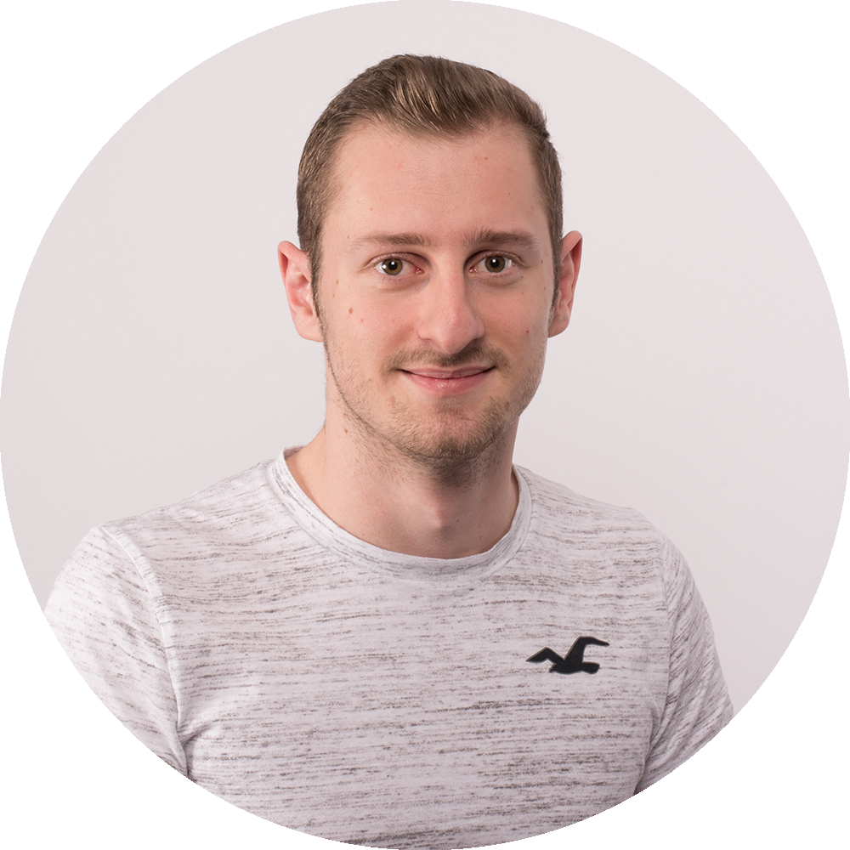
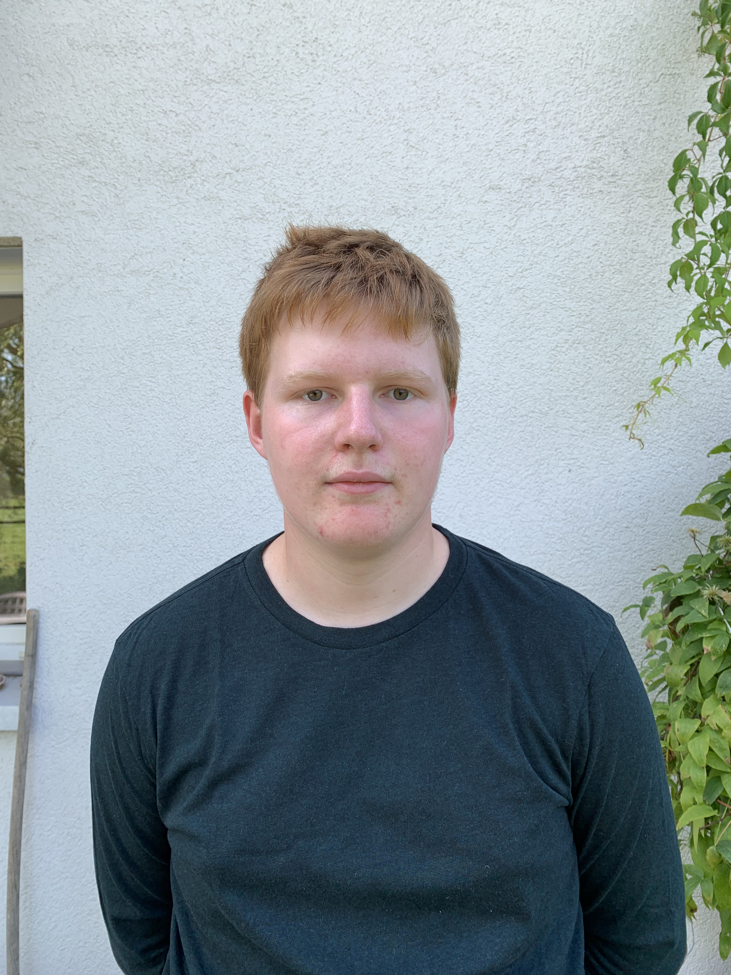
Who we are
Patrick Bühlmann Middleware Engineering
Nathanael Liechti Middleware Engineering - Lernender
Work area:
Kubernetes / OpenShift Engineering
Docker, Cloud, Automation
DevOps CI / CD
Work area:
Kubernetes Engineering
Go Coding (Microservices and more)
+41 76 342 82 59
+41 76 416 81 33
-
-
patrick.buehlmann.1@post.ch
nathanael.liechti@post.ch

Slide 5
Who are you? A short introduction
What is your name?
Do you have experience with Docker, Kubernetes or in generally Container?
How motivated are you from a scale 0 (bad) to 10 (verry god)?

Slide 6
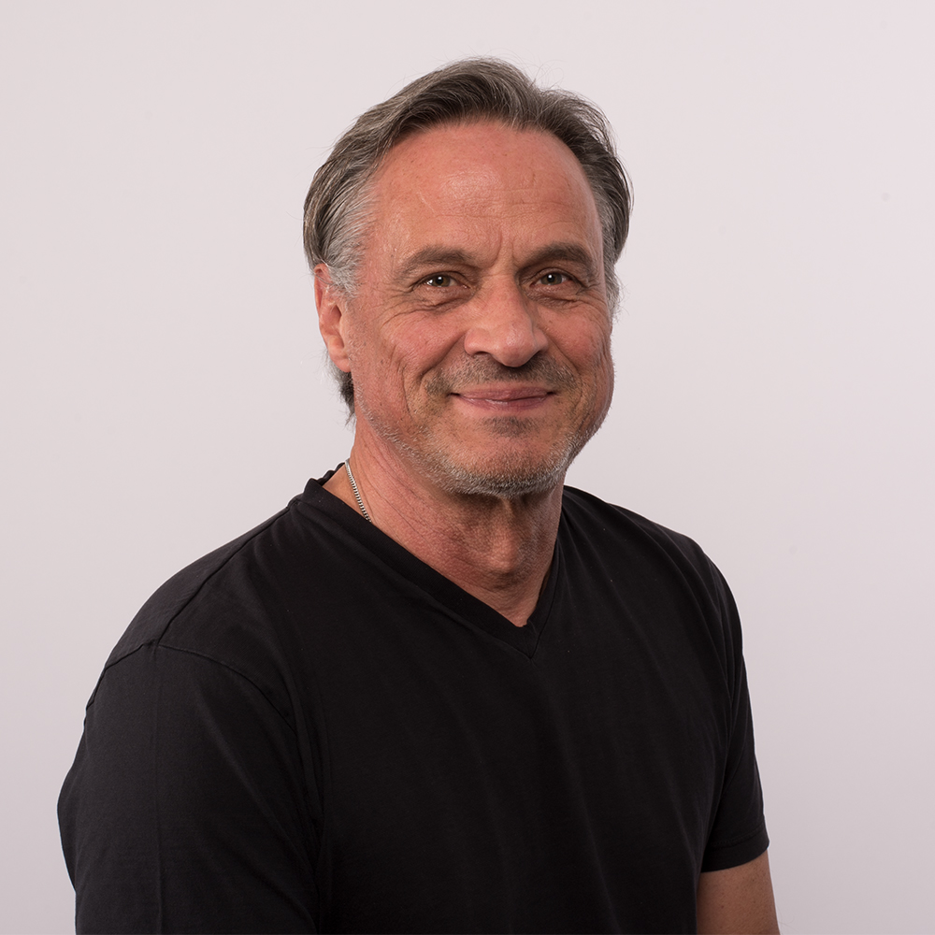
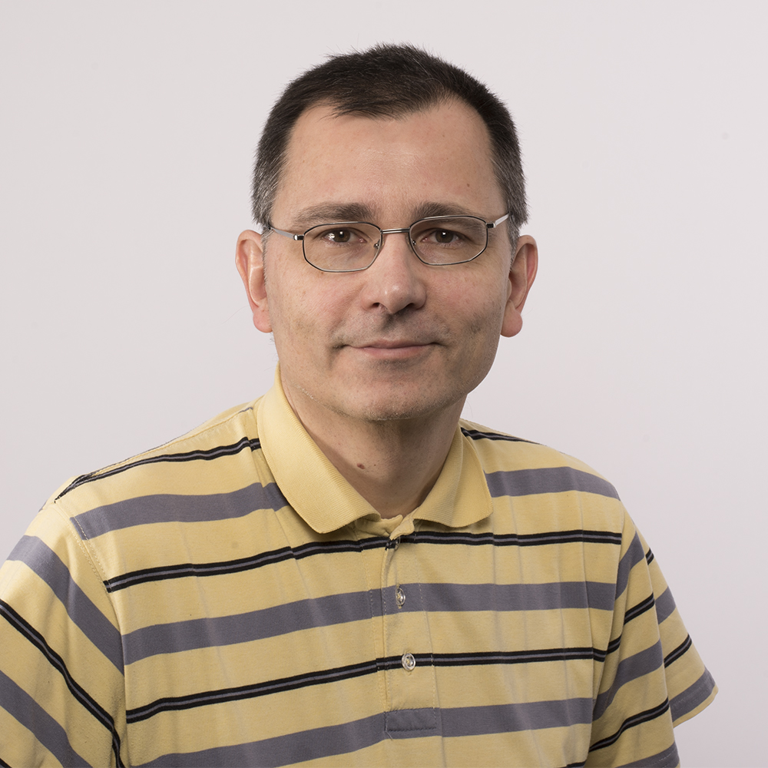
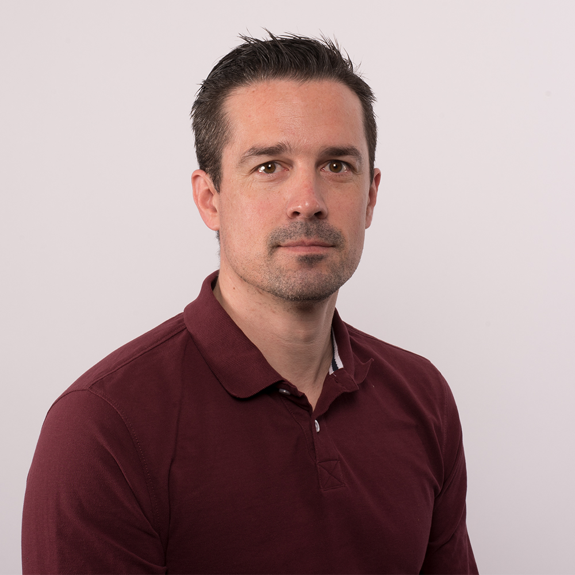
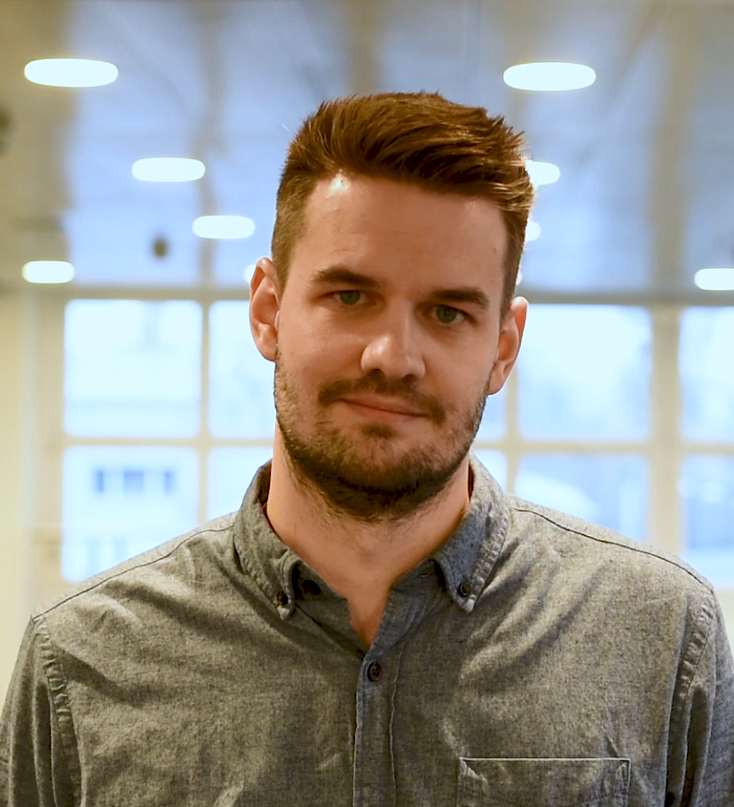

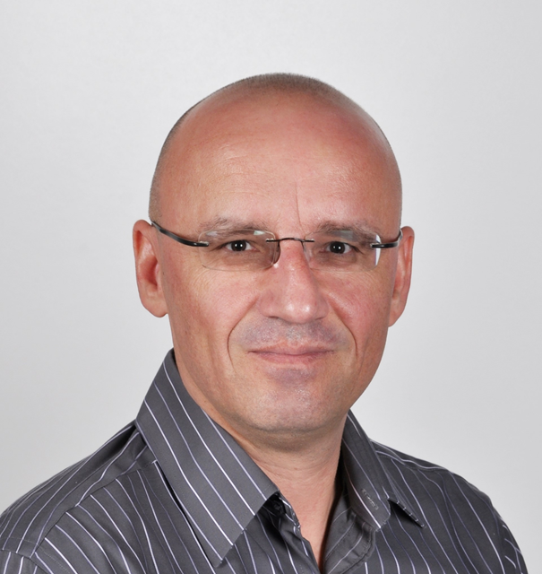
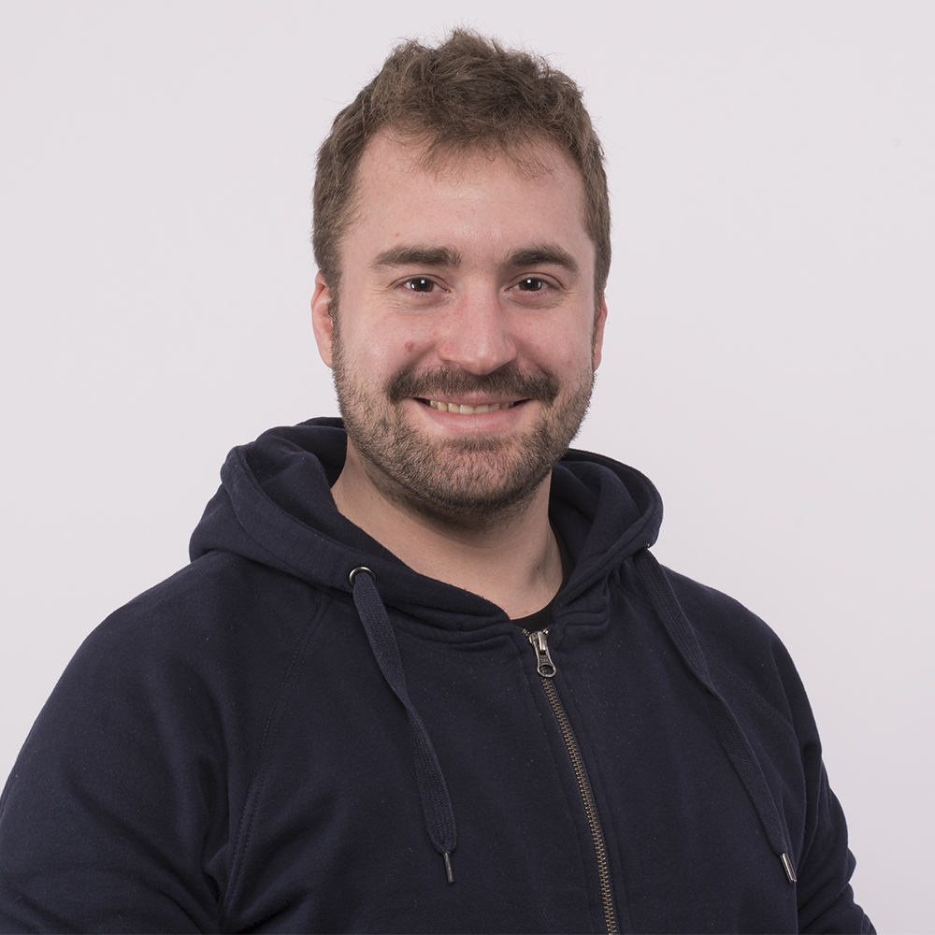
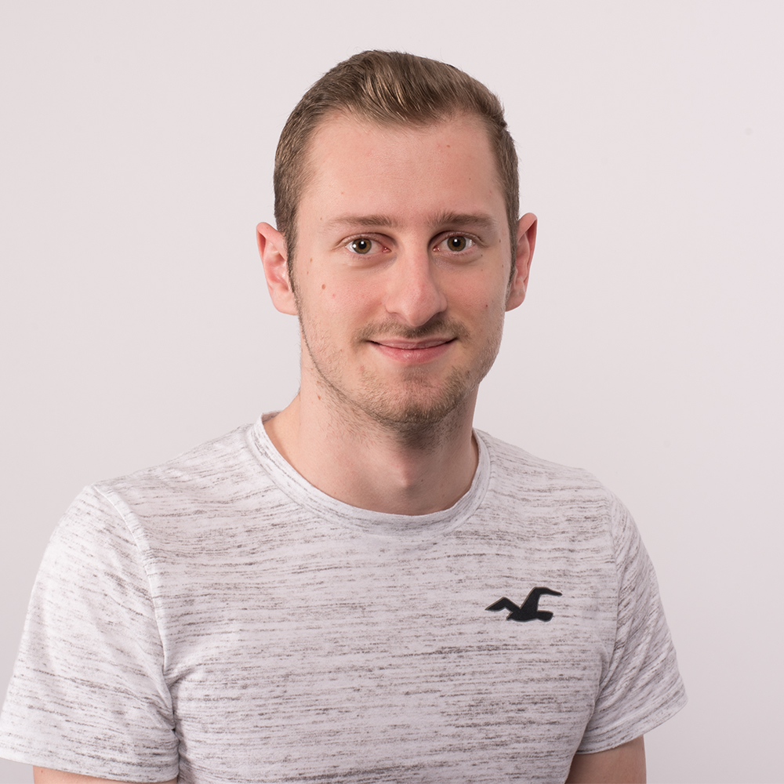
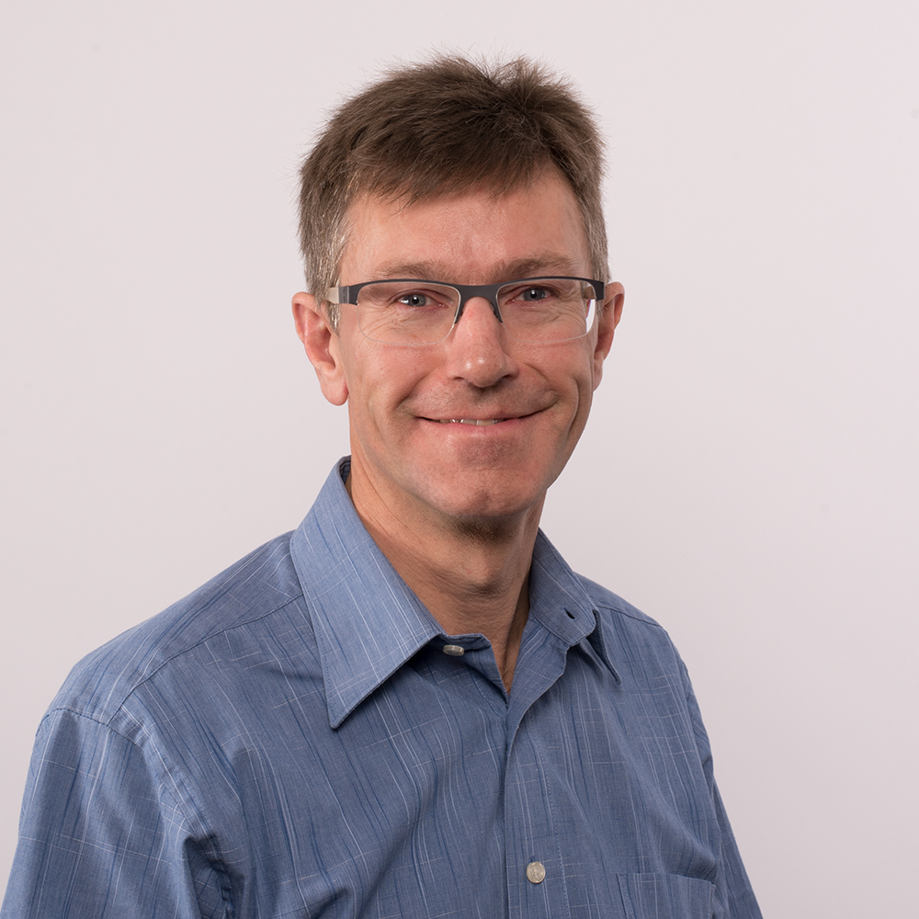
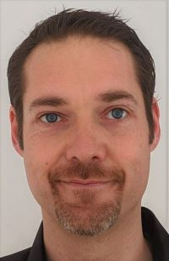
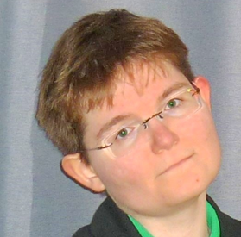
Middleware Engineering – I253 Our team

Slide 7
Middleware Engineering What is Engineering?
Systematic design of computer science systems
Create and implement concepts / products
ICT-System-Ingenieur:
Planning, procurement, commissioning, testing and acceptance of platforms (hardware, software, networks, including cloud environments) for the operation of ICT systems; definition of operational requirements
https://www.berufe-der-ict.ch/berufe/entwicklung/ict-system-ingenieur

Slide 8

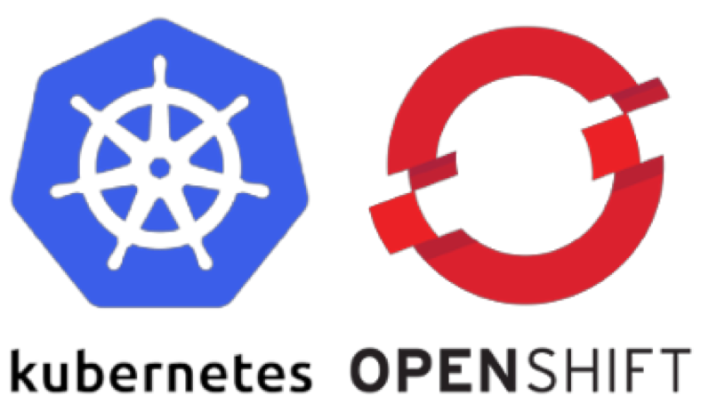
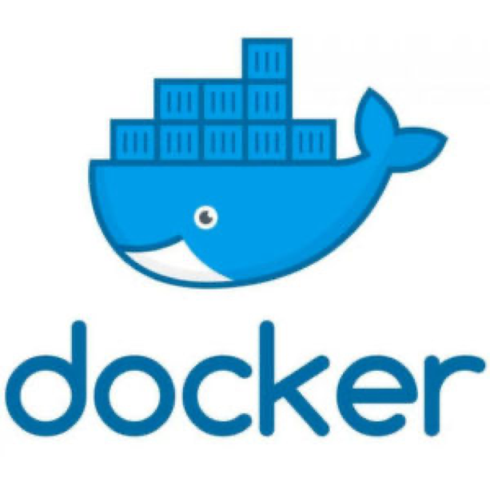







Middleware Engineering Engineering Tools

Slide 9
Middleware Engineering What does an Engineer in his daily business?
Scripts, Automate
Terminal, Shell
Work with Linux all day long
Searching and developing new solutions
Try somthing new
Questioning the existing
Interest in system / network

Slide 10
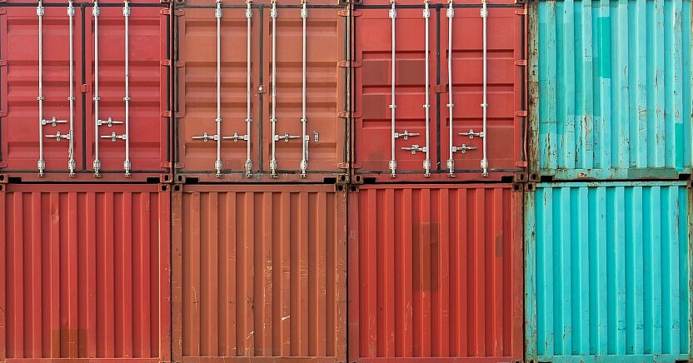
Container What is a container?

Slide 11
Container What is a Container?
“Containers are a form of operating system virtualization. A single container might be used to run anything from a small microservice or software process to a larger application. Inside a container are all the necessary executables, binary code, libraries, and configuration files. Compared to server or machine virtualization approaches, however, containers do not contain operating system images. This makes them more lightweight and portable, with significantly less overhead. In larger application deployments, multiple containers may be deployed as one or more container clusters.
Such clusters might be managed by a container orchestrator such as Kubernetes.”

Slide 12
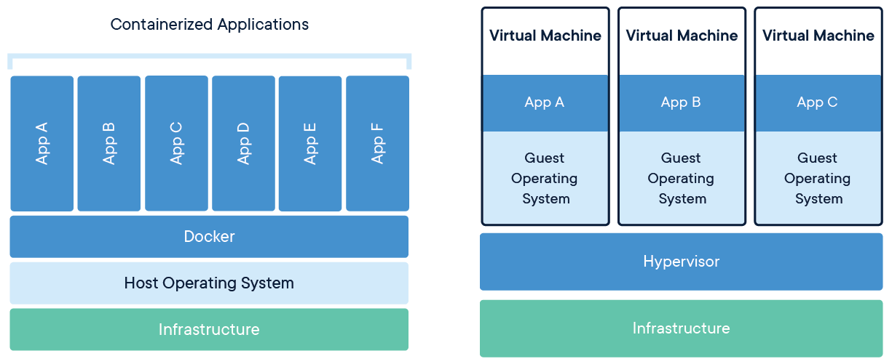
Container Comparison between Container and Virtual Machines
Share kernel and isolate the application process
Extremly portable
Very lightweight
One process in a container
No data in a container (use volumes)

Slide 13
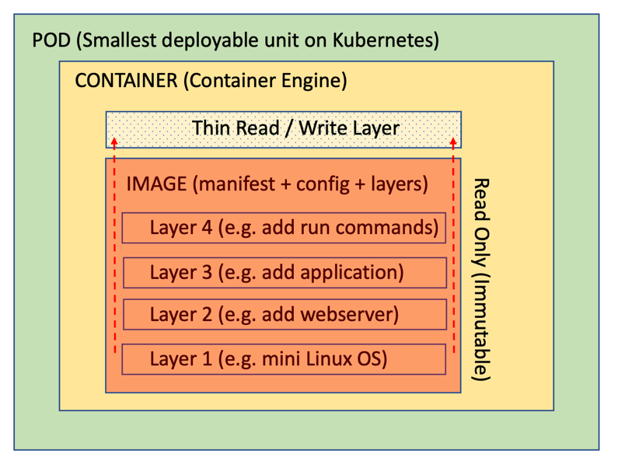
Container Inside of a Container

Slide 14
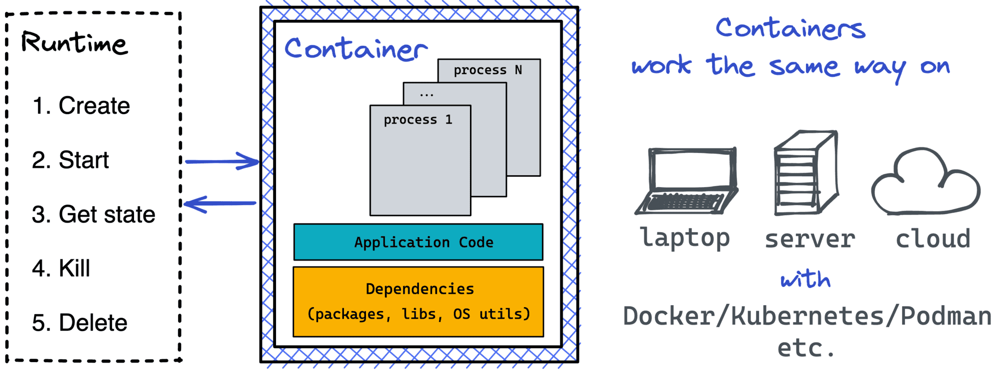
Container Interact with a Container

Slide 15

Container Benefits of containers
Less overhead
Increased portability
More consistent operation
Greater efficiency
Easier application development (less dependencies)
Much faster deployment
Save costs
Notes:
Less overhead Containers require less system resources than traditional or hardware virtual machine environments because they don’t include operating system images.
Increased portability Applications running in containers can be deployed easily to multiple different operating systems and hardware platforms.
More consistent operation DevOps teams know applications in containers will run the same, regardless of where they are deployed.
Greater efficiency Containers allow applications to be more rapidly deployed, patched, or scaled.
Better application development Containers support agile and DevOps efforts to accelerate development, test, and production cycles.

Slide 16
Docker Create, deploy and run Containers

Slide 17
Docker What is Docker?
Docker is a software platform designed to make it easier to create, deploy, and run applications by using containers. It allows developers to package up an application with all the parts it needs in a container, and then ship it out as one package.
Build, share and run any application, anywhere
Notes:
There are other softwares that can do the same

Slide 18
Docker Container Docker Mechanism
Repository
Host
Image
Container
Registry
Docker Client
Daemon

Slide 19
Docker Container Workflow
Image
Container
Build
Run
Pull
Stop
Delete
Delete

Slide 20
Docker Container Docker Engine Commands
Container
Image
build
pull
tag
Rmi
logs
inspect
ps
Stop
kill
rm
bhjhfdjhfjdshshfdjfhsfkjdshfkjhsjhfdkjhf
run
start

Slide 21

Docker Container Installation of Docker
https://www.digitalocean.com/community/tutorials/how-to-install-and-use-docker-on-debian-10

Slide 22
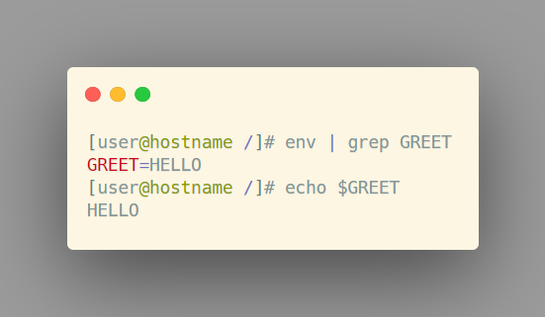
Docker Container Docker Runtime environment variables
Environment Variables docker run –it \ -e GREET=HELLO \ --rm centos

Slide 23
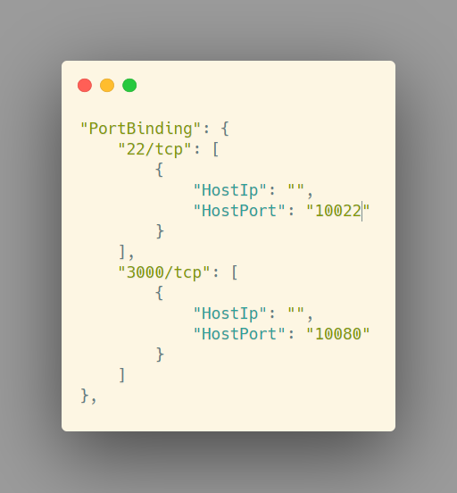
Docker Container Docker Runtime networking
Port translation docker run … -p 10022:22 …

Slide 24
Docker Container Docker Runtime volumes
Mount a directory from the host into the container docker run … -v /data/db:/var/lib/db …

Slide 25
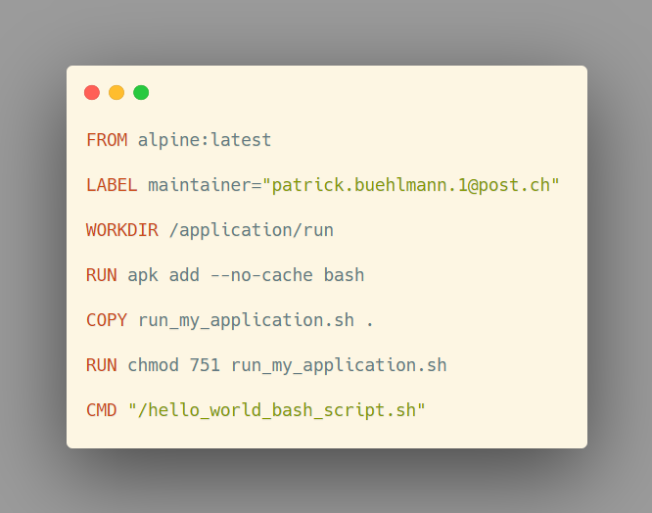

Docker Container The dockerfile is the truth
Dockerfile
Image
Container
Instruction-bases image build
FROM, ADD, RUN, COPY, CMD, USER
Cached layers
Dockerfile Cheat Sheet

Slide 26
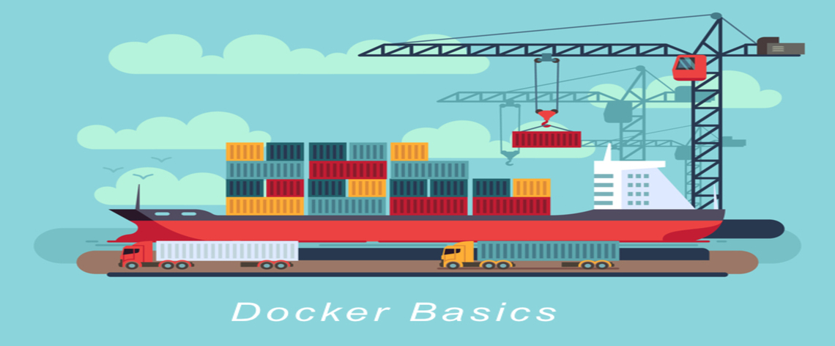
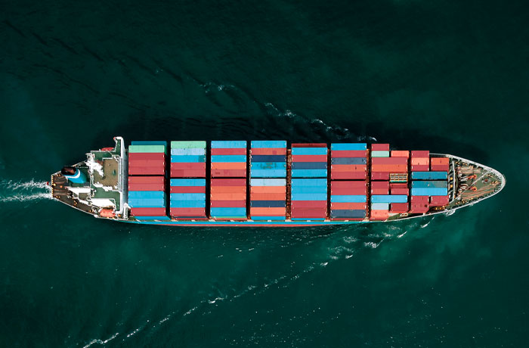
Fliesstext in einer Textspalte Schriftgrösse und Spaltenaufteilung
Fliesstext
Bei einem Layout mit einer Textspalte (ganzseitig) wird die für Fliesstext definierte Schriftgrösse verwendet. Die Schriftgrösse ist im Folienmaster festgelegt.
Technische Angaben Fliesstext
Frutiger Light, 20 Punkt; Zeilenabstand 1 Zeile; Nach einem Absatz 10 Punkt; Farbe Schwarz; Auszeichnungen im Text in Frutiger Bold

Slide 27
DOCKER EXERCISE «Hello World 1»

Slide 28
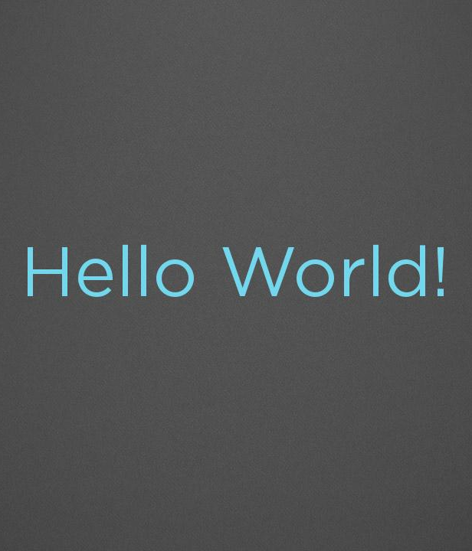

Docker Exercise Hello World 1
docker run hello-world
docker ps –a
docker images

Slide 29
DOCKER EXERCISE «Hello World 2»

Slide 30
Docker Exercise Hello World 2
Choose the right and a small base image (alpine, centos)
Create a bash script
Build and run the container
Is there a faster way?

Slide 31
DOCKER EXERCISE «Webserver»

Slide 32
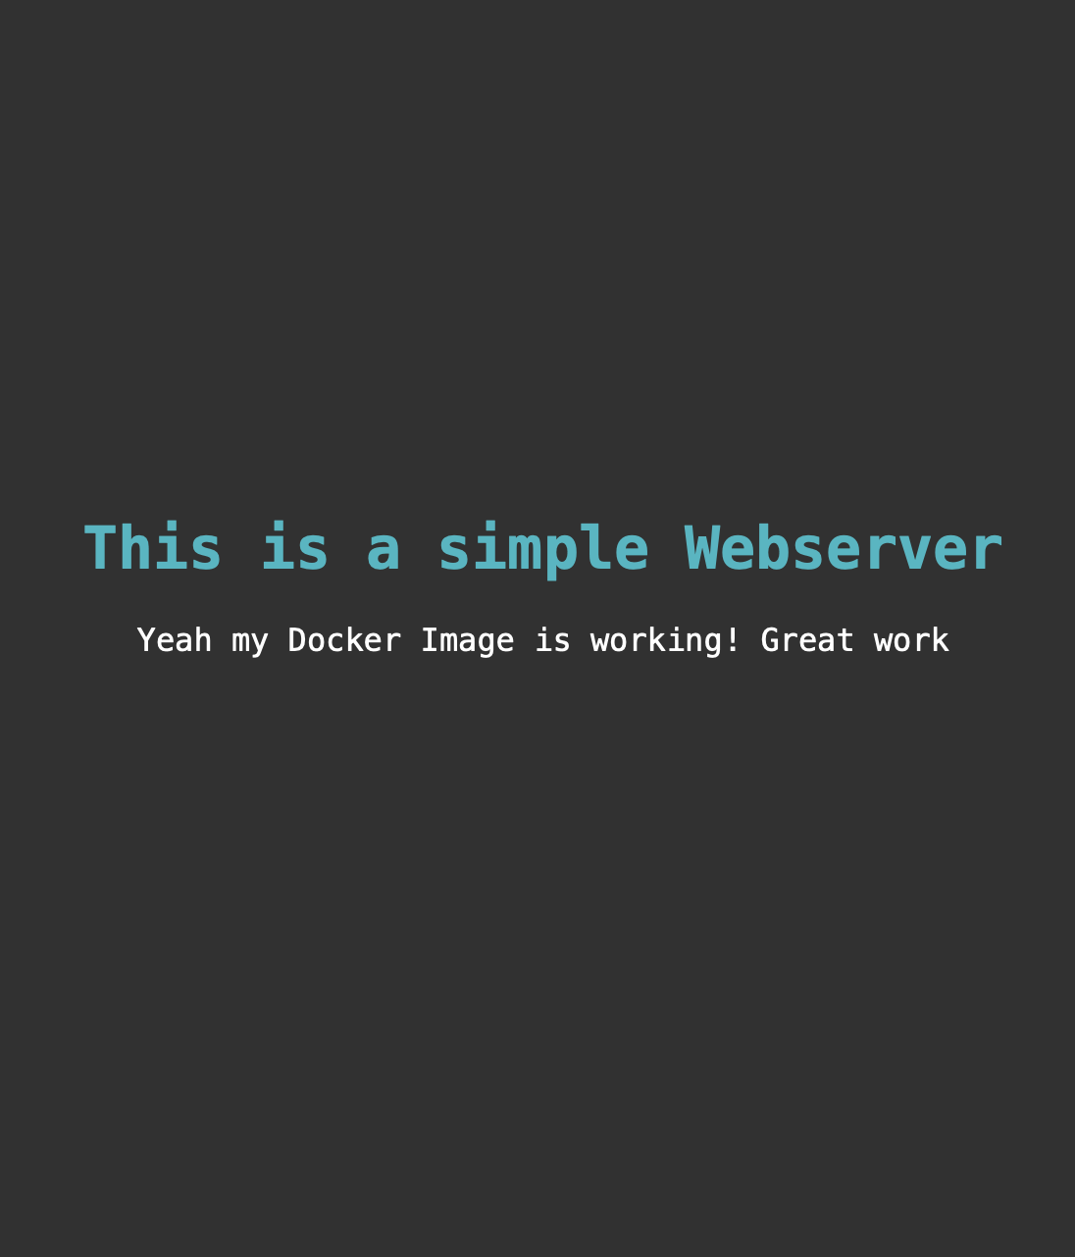
Docker Exercise Webserver
Choose the right and a small base image (alpine, centos)
Install an apache http server
Create an index.html file and paste it to the web folder of the apache server
Build and run the container in the detached mode (background)
Start and stop the images «helloworld» and «webserver» with a single docker-compose file

Slide 33
DOCKER EXERCISE «Gitea»

Slide 34
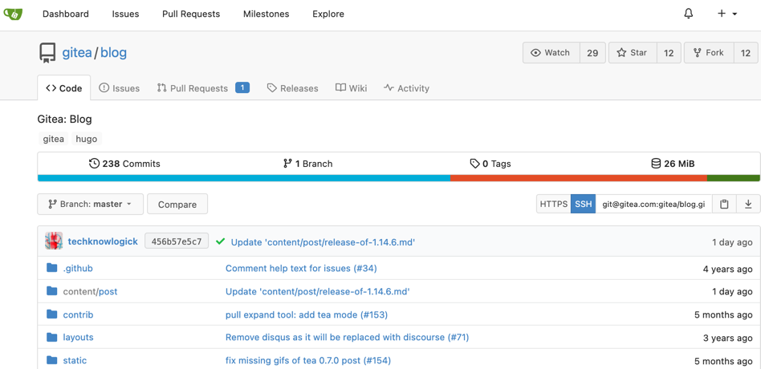

Docker Exercise Gitea – self hosted Git
Write a docker-compose file
docker-compose up -d
Finish the setup on http://localhost:3000 (don’t forget the admin user!)
Create and clone a repository
What happens when you stop the container?

Slide 35
DOCKER EXERCISE «JSWiki»

Slide 36
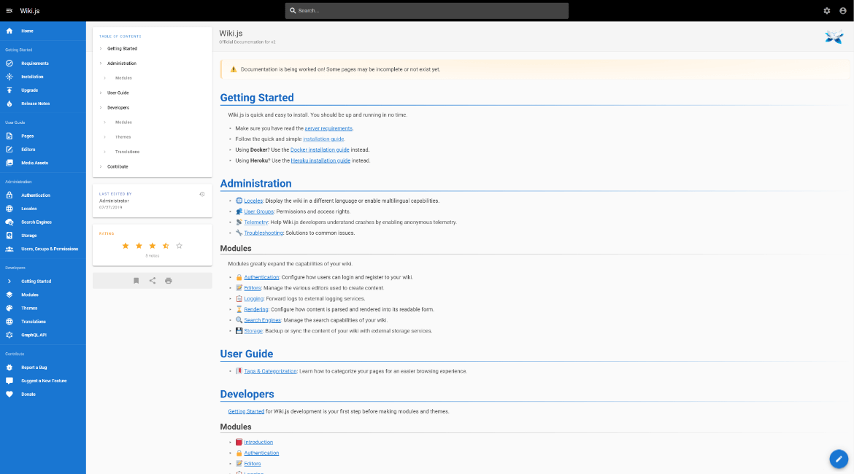

Docker Exercise JSWiki
Open a text-editor and write your docker run command (using sqlite as database)
Start the container
Finish the setup on http://localhost:8080
Write your first page!

Slide 37
DOCKER EXERCISE «Filebrowser»

Slide 38
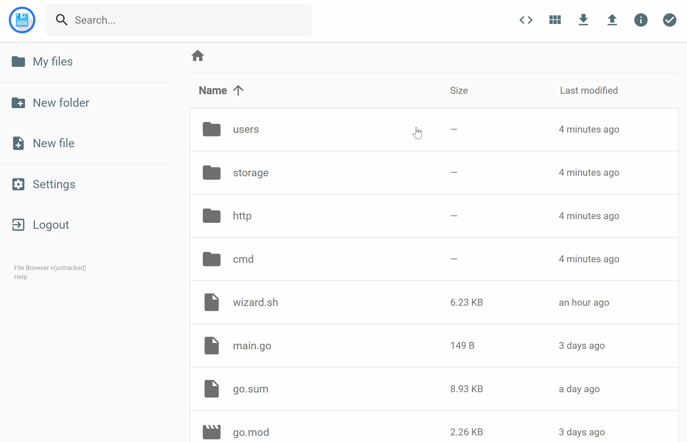

Docker Exercise Explanation of the exercise
Create a docker volume for the files
Open a text-editor and write your docker run command
How do you mount a docker-volume inside a container

Slide 39
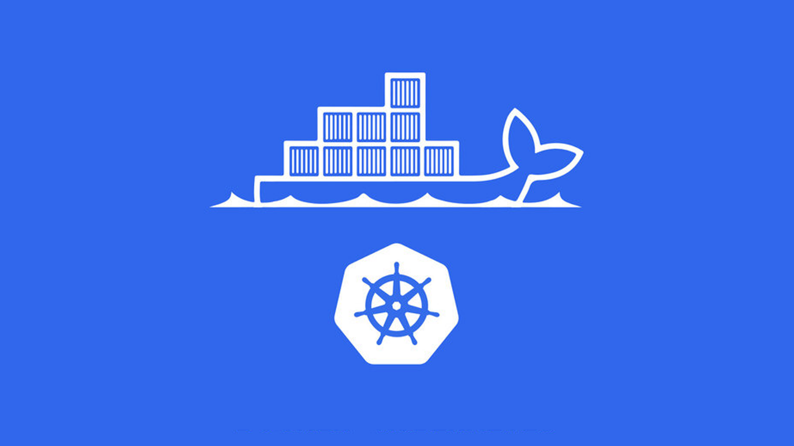

Kubernetes @

Slide 40
Kubernetes@Post Key Figures
Key figures
Running Container: 3’400
Used Container Nodes: 220
Application purpose
PostAuto Backend
Chatbot and Livechat
Postshop Backend
Automation and Logging Tools

Slide 41
Kubernetes Containerisation with K8S

Slide 42
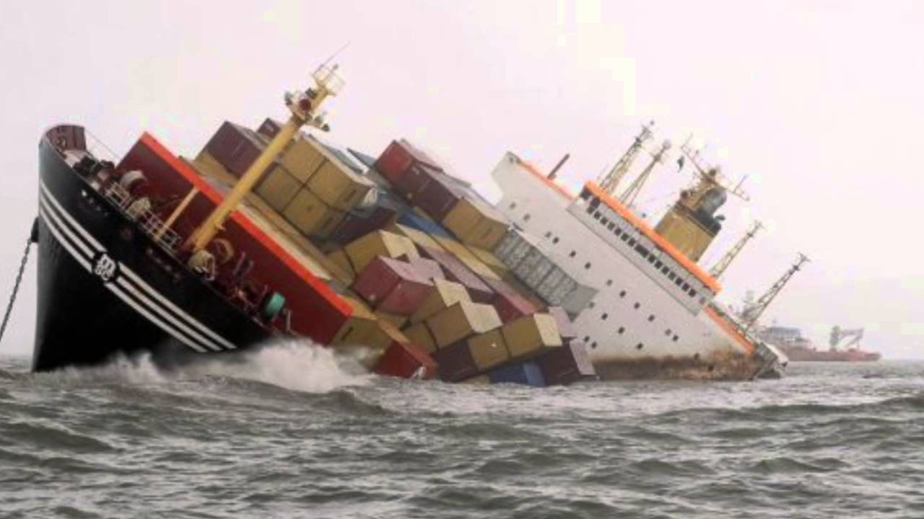
Kubernetes What docker looks like in production

Slide 43
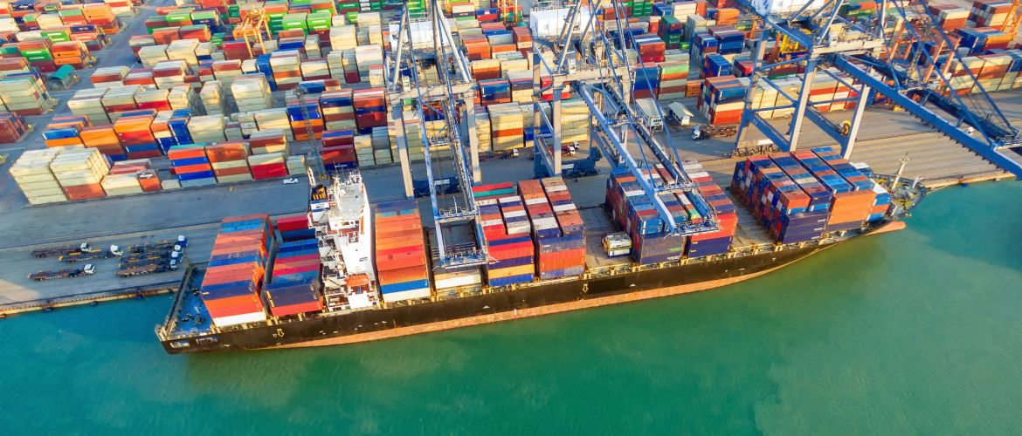
Kubernetes What Kubernetes looks like in production

Slide 44


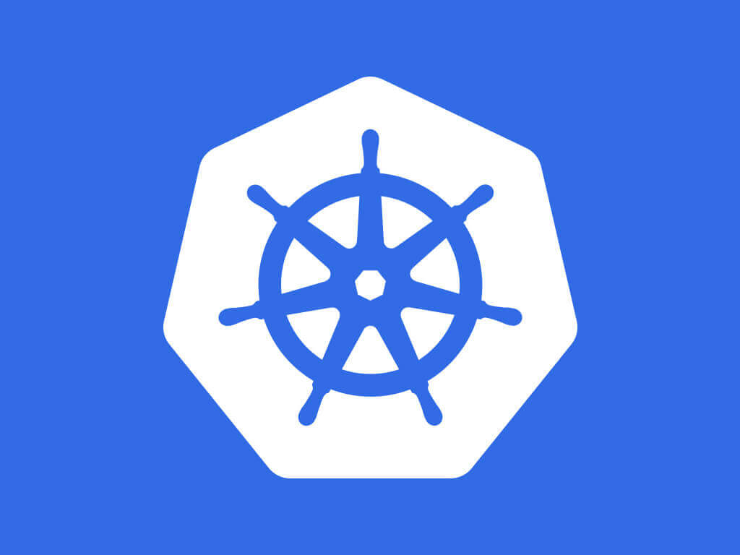





Kubernetes What is Kubernetes?
User Experience
kubectl
Orchestration
Container Engine
Container Host

Slide 45
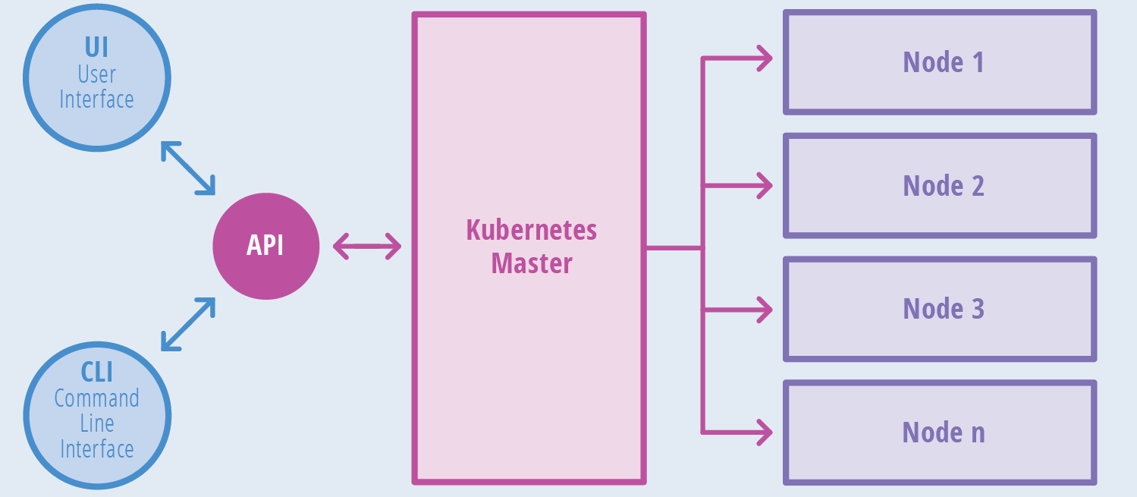
Kubernetes What is Kubernetes

Slide 46


Kubernetes Live Demo
Live Demo

Slide 47

Questions? mweng@post.ch

